Slide 1



Veermata Jijabai Institute of Technology
PARALLELIZING AES CRYPTOGRAPHIC ALGORITHM USING MPI
PRESENTED TO
Proff. Prathamesh Kadam
PRESENTED BY
Rushil Shivade
201080053
IT
08-05-23

Slide 2

Overview
The Advanced Encryption Standard (AES) is a widely used symmetric encryption algorithm that provides strong encryption and decryption of digital data.
AES works by dividing the plaintext data into blocks of 128 bits and encrypting each block separately.
The encryption process involves multiple rounds of mathematical operations, including substitution, permutation, and mixing of bits, which are designed to create confusion and diffusion of the data.
AES uses a key of fixed length, either 128, 192, or 256 bits, to encrypt and decrypt the data.
The strength of the encryption increases with the length of the key, making it harder for an attacker to crack the encryption by trying all possible key combinations.
AES has become the standard encryption algorithm for securing data in a wide range of applications, such as banking transactions, email communication, and government documents.

Slide 3



Serial Approach
A naive approach to AES algorithm using the Cryptodome/PyCrypto Library in Python.
In the serial implementation, the input text or plaintext is padded to a multiple of the block size, which is 16 bytes for AES encryption.
The encryption or decryption process then uses a unique counter value for AES in CTR mode, along with the input key, to create a new instance of the AES cipher for each block of input text.
The AES algorithm has four main stages: SubBytes, ShiftRows, MixColumns, and AddRoundKey.
These stages are applied sequentially to each block of input text until the entire text is processed. The resulting ciphertext is then output for encryption or the resulting plaintext is output for decryption.
The serial implementation of AES algorithm can be slow for large amounts of input data, since each block must be processed sequentially on a single processor or core.

Slide 4
Parallel Approach
MPI is a library specification for message-passing between parallel processing nodes, commonly used in high-performance computing (HPC).
In a parallel implementation of AES using MPI, the data is divided into equal-sized blocks, and each block is assigned to a separate process.
The encryption and decryption process of AES consists of multiple rounds, and each round involves several operations that has been parallelized.
Steps:
Initialize MPI
Divide the input data
Broadcast the AES key
Perform encryption or decryption
Gather the results
Finalize the MPI environment.
Parallelizing the AES algorithm using MPI can significantly improve the performance of the algorithm on distributed memory systems.

Slide 5
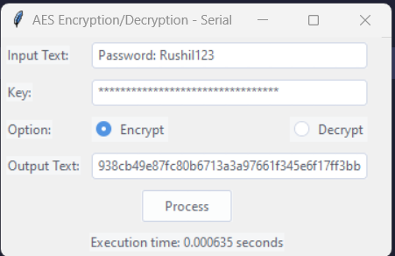
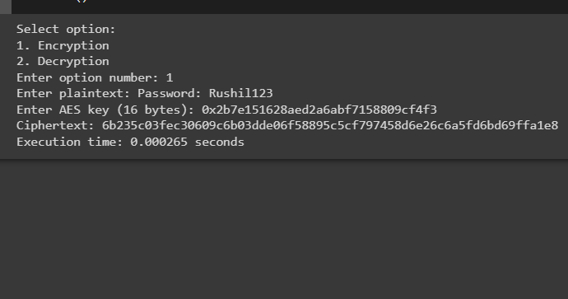

Execution time
Serial Approach
Parallel Approach

Slide 6
Conclusion
As we can see in the screenshots, the execution times of serial and parallel approach are significantly different.
The parallel approach is very efficient in terms of time complexity.
This difference may seem small as far as the actual amount of time is concerned but as the input text becomes large, it will result in a substantial difference.
Serial Approach: 0.000635 sec
Parallel Approach: 0.000265 sec
Ratio of Serial/Parallel = 2.396
More than 2X Faster

